Slide 1
Unused medicine donation for ngo’s
Online website for the donation of unused medicines to ngo’s

Slide 2
About the website :
As the internet has become more prominent source of communication, the NGO’s should also have a online website.
Through this website we will be able to reach out to more wider range of donors.
This website is basically used to donate unused medicines to the nearby NGO’s or any needy person.
We deliver medicines to the NGO’s according to the requirements.
We make sure that no medicine is wasted and for that we keep a directory of the available medicines according to the requirements.

Slide 3
Operating system & entities :
In this drug donation system there are exactly three entities that helps in functioning and working the website in the best way possible :
ADMIN
NGO
MEMBER

Slide 4
Admin panel :
Admin is the most important entity with the maximum controls over the website.
Admin will login and manage members by deleting and blocking the users providing improper or expired medicines.
Admin also has the authority to approve the sign up forms of different NGO’s.
He / She also has to maintain a record over the available medicines and the required ones.
Admin has also a monthly report of all the medicines donated by the users.

Slide 5
NGO :
NGO can raise a request by signing up using there credentials and then they have to wait for the admin to approve their request.
If the admin approves the request of the NGO then it becomes a registered can request medicines according to the availability.
The delivery of the medicines can be done by two ways : 1. The donor will deliver the medicine.
2. NGO can pick up the medicine.

Slide 6
MEMBER :
Anyone can become a member of the drug donation program by filling up the “Donate us” form.
For the donation of the medicines the donor has to raise a request by filling the form along with the medicine name and its details.
The admin approves the request after checking the details and the expiry dates of the medicine.
After approving the request the admin and the NGO schedules the donating date, which is informed to the donor by a call or a text message.
Members can also check their previous data of medicine transactions.

Slide 7
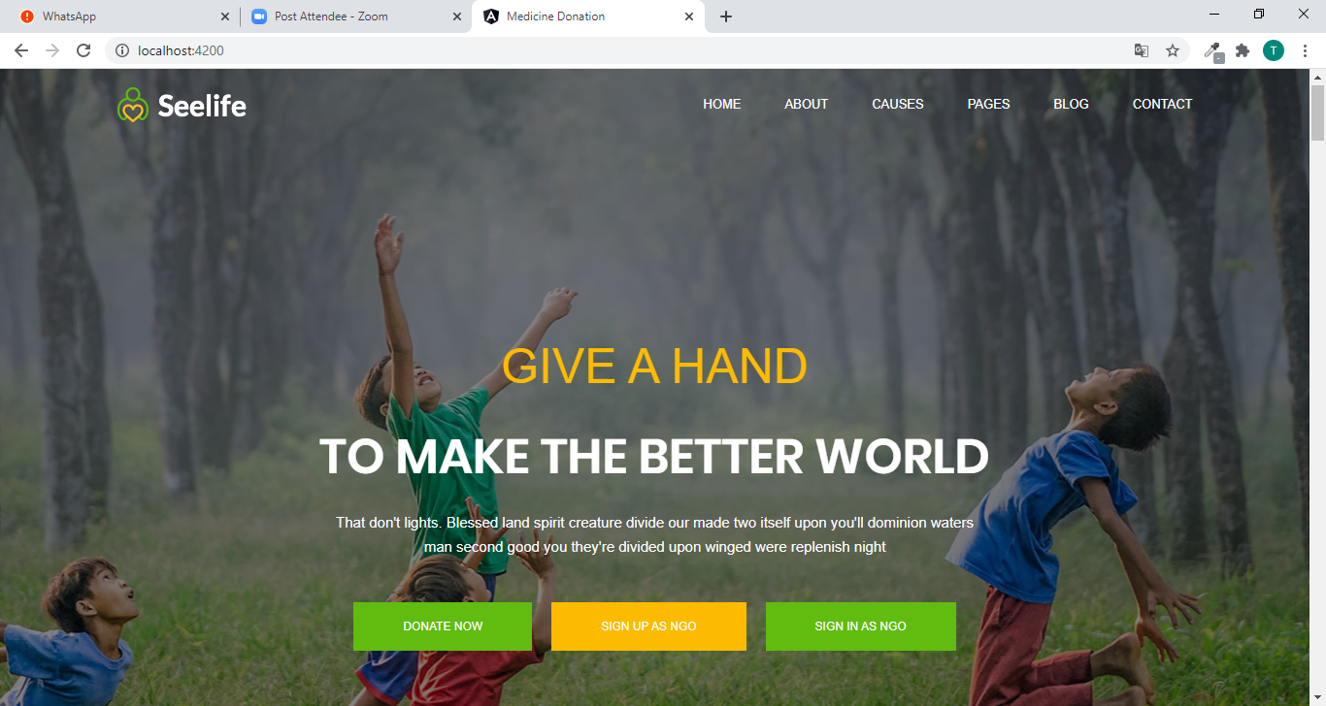
Website navigation :
The form provides three forms to the users : Direct donation form
Sign up for NGO
Sign in for NGO
On the top right corner user can see six other options which will provide information and the cause behind this website : HOME, ABOUT, CAUSES, PAGES, BLOG, and CONTACT.

Slide 8
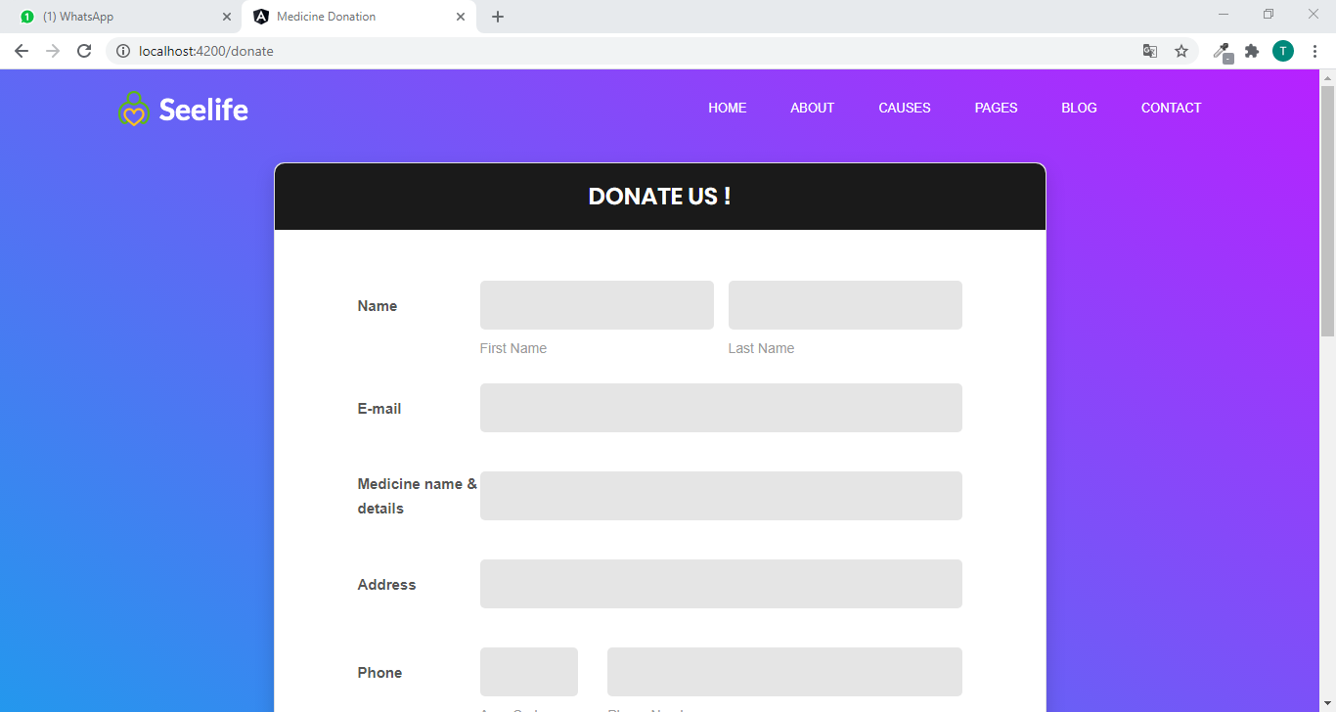
Donation form :
By filling up this donation form anyone can contribute in this drug donation system.
The donor just have to fill up the details about the medicine and they will get the information regarding the day of donation by a call or text message.
Donors can even check the details of their previous donations.

Slide 9
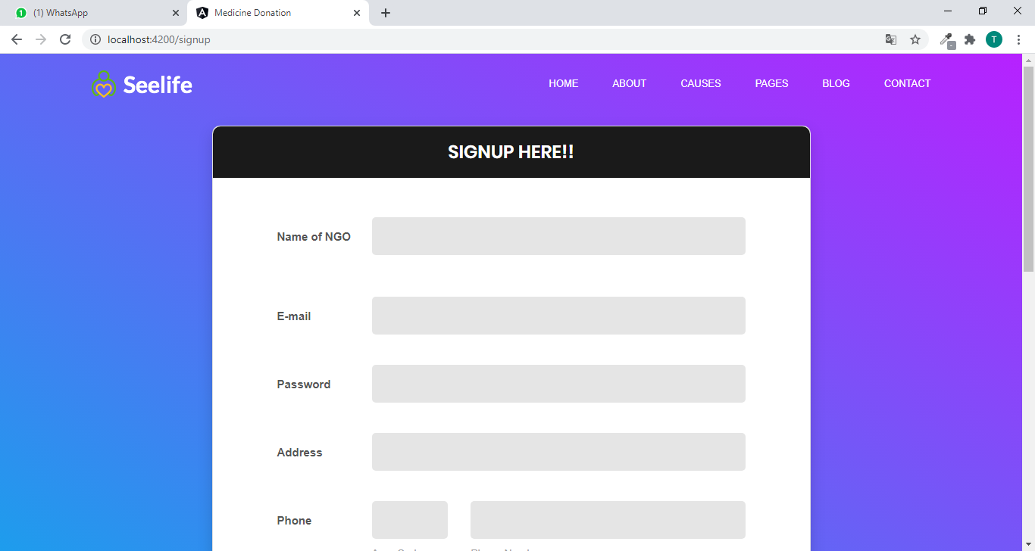
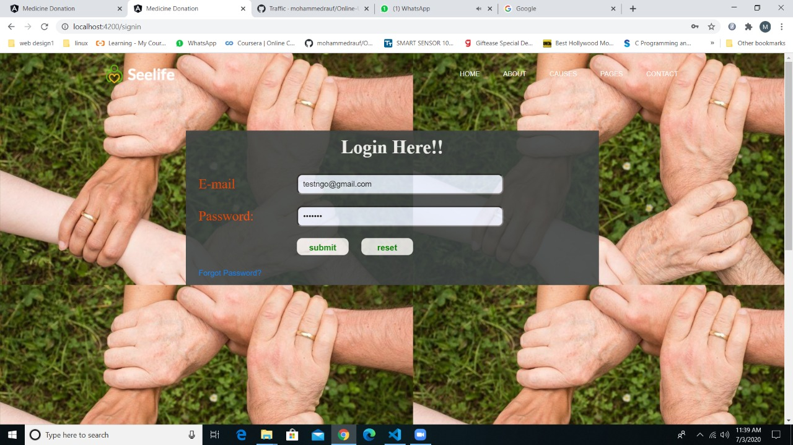
Ngo registrations :
Sign up as NGO :
Sign in as NGO :
By entering the information any NGO can be registered in the website by raising a request to the admin.
Registered NGO can log in to their account by entering the credentials.

Slide 10
Advantages & disadvantages :
ADVANTAGES :
It helps poor people for medication.
It will help to maintain records of medicines.
Many needy people will get cured.
DISADVANTAGES :
This application requires an active internet connection.
User needs to put correct data or else it behaves abnormally.

Slide 11
Thank you !

